Slide 1
April 2026
SALES PERFORMANCE
ANALYSIS
Strategic Insights & Growth Roadmap | FY 2015-2017

Slide 2
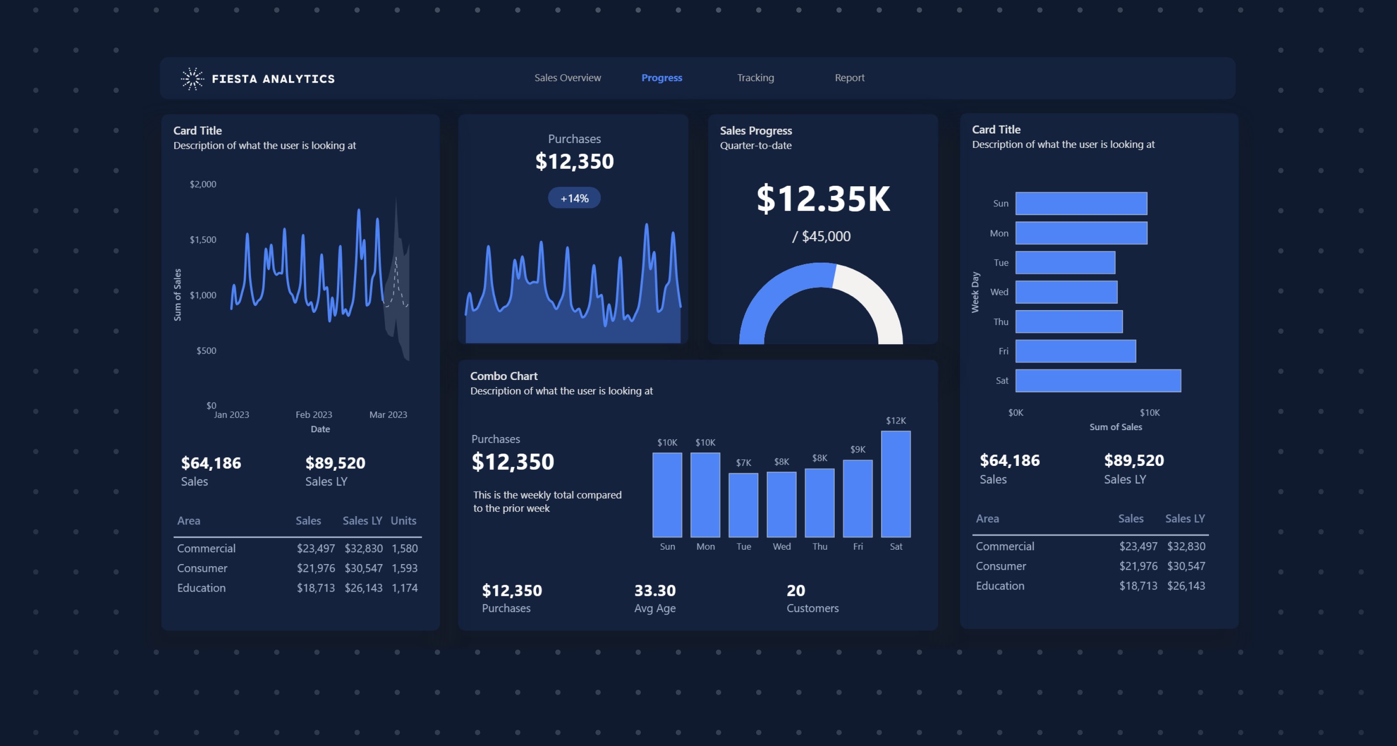
AGENDA
01 Executive Summary | 02 Key Findings & Insights
03 Strategic Recommendations

Slide 3

01 EXECUTIVE
SUMMARY
All core metrics exceed targets, but profit growth lags behind volume growth — signaling margin pressure.

Slide 4
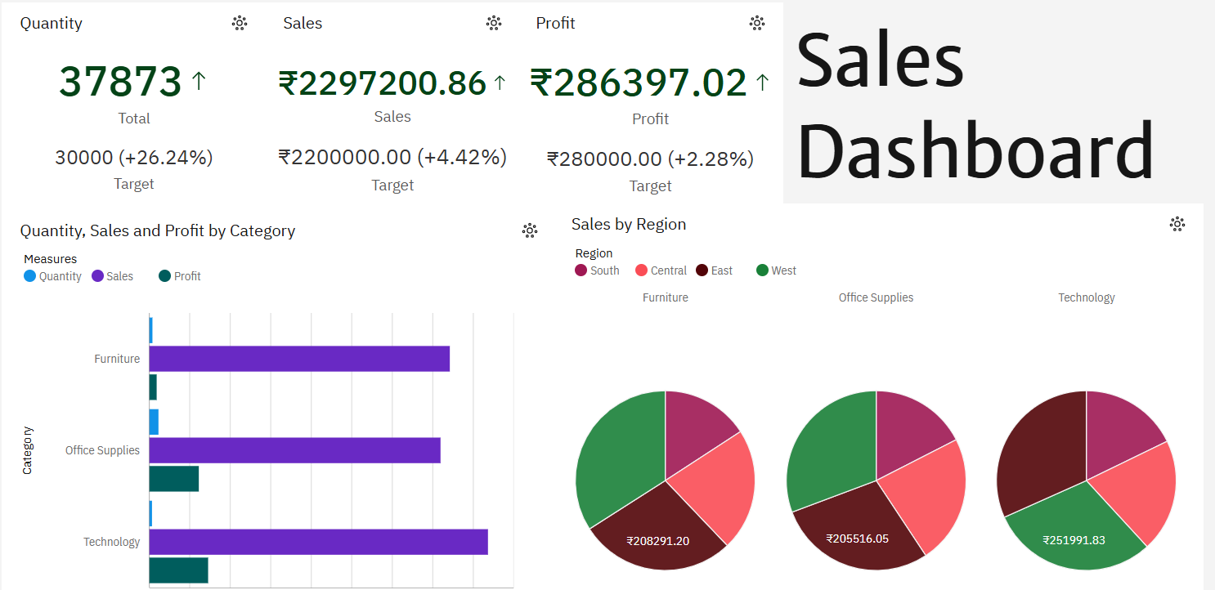

Slide 5
KPI DASHBOARD
Key Insight: Quantity grew +26.24% but Profit only +2.28% — margin per unit is compressing
37,873 | Total Quantity | Target: 30,000 +26.24% above target
22.97L | Total Sales (INR) | Target: 22.00L +4.42% above target
2.86L | Total Profit (INR) | Target: 2.80L +2.28% above target

Slide 6

02 KEY
FINDINGS
Deep-dive into category performance reveals divergent profitability patterns across Furniture, Office Supplies, and Technology.

Slide 7
CATEGORY PERFORMANCE — Divergent Profitability Patterns
Furniture — Red Flag
High sales (₹2.08L) but minimal profit (~₹5K) and very low volume. Worst profit-to-sales ratio in the portfolio.
Technology — Revenue Driver
Highest sales (₹2.52L) with moderate profit. Drives top-line but needs margin focus to improve bottom-line.
Office Supplies — Steady Performer
Most balanced profile: high quantity (15K+ units), solid sales, and healthy profit margins.

Slide 8
SALES BY REGION
Insight: Regional strengths are category-specific — cross-sell underperforming categories in strong regions

Slide 9
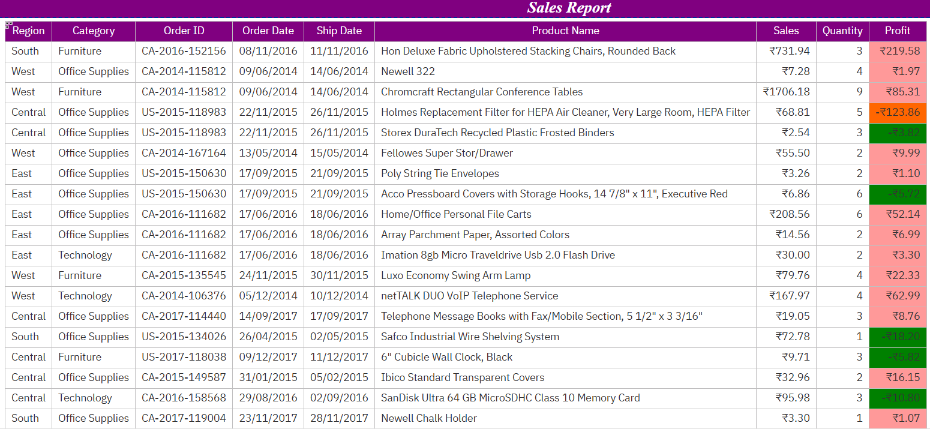

Slide 10

03 STRATEGIC
RECOMMEN
DATIONS
From data to action — addressing margin gaps, loss-making SKUs, and regional optimization.

Slide 11
PROBLEM AREAS — Margin Compression & Loss SKUs
CRITICAL
WARNING
CRITICAL
Margin Compression
Furniture Category
Loss-Making SKUs
Profit growth (+2.28%) severely lags quantity growth (+26.24%). Average margin per unit has declined significantly.
Impact: Every additional unit sold contributes less to bottom line than before.
High sales value (₹2.08L) with minimal profit. High-ticket items like conference tables and chairs yield poor returns.
Impact: Capital tied up in low-margin inventory that could be reallocated.
Multiple products show negative profit: Holmes Odor Grabber, Logitech Keyboard, Woodgrain Magazine Files.
Impact: These SKUs actively destroy value with every sale. Immediate action required.

Slide 12
ACTION PLAN — Prioritized Solutions
Immediate
Short-Term
Medium-Term
Ongoing
Discontinue or reprice 3 loss-making SKUs identified in the dataset.
Owner: Product Team
Timeline: 2 weeks
Review Furniture pricing strategy. Investigate why high-ticket items yield minimal profit.
Owner: Pricing Team
Timeline: 1 month
Expand Technology in West and Central regions where it currently underperforms.
Owner: Sales Team
Timeline: 3 months
Implement dynamic margin tracking dashboard to prevent future profit-quantity divergence.
Owner: Analytics Team
Timeline: Continuous
Expected Outcome: 15-20% profit improvement within 6 months through SKU optimization and pricing correction

Slide 13
KEY TAKEAWAY
"Volume is growing, but margins are thinning.
The path to sustainable growth lies in optimizing
category mix, eliminating loss-making SKUs,
and aligning regional strategies with profit goals."
Target: 15-20% Profit Improvement | Timeline: 6 Months

